Slide 1
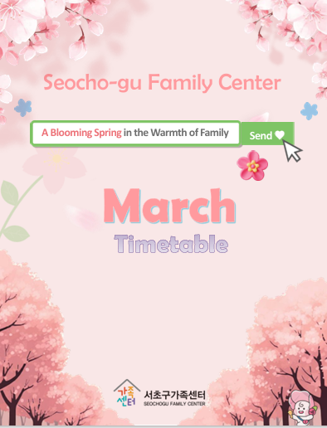

Slide 2
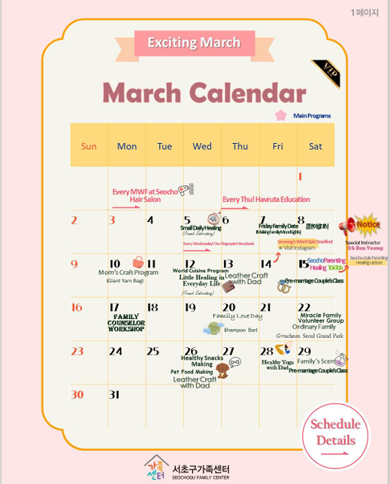

Slide 3
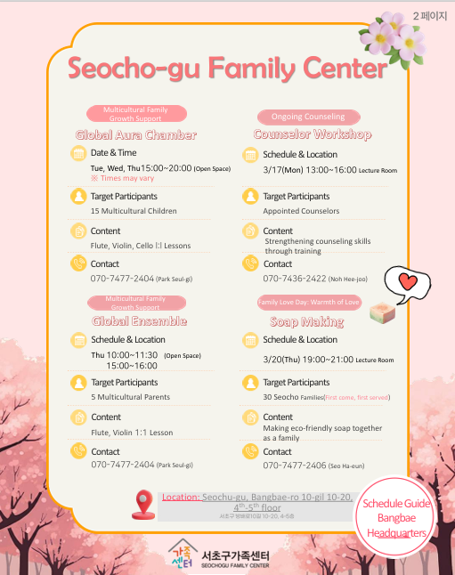


Slide 4
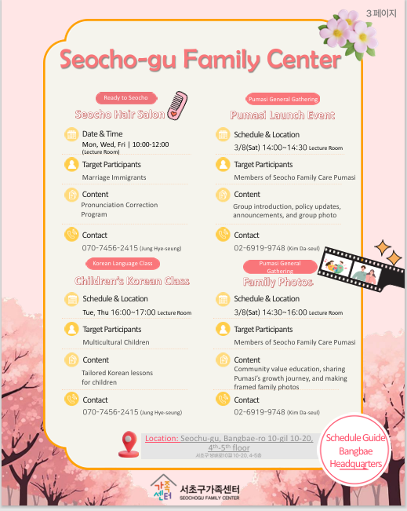

Slide 5
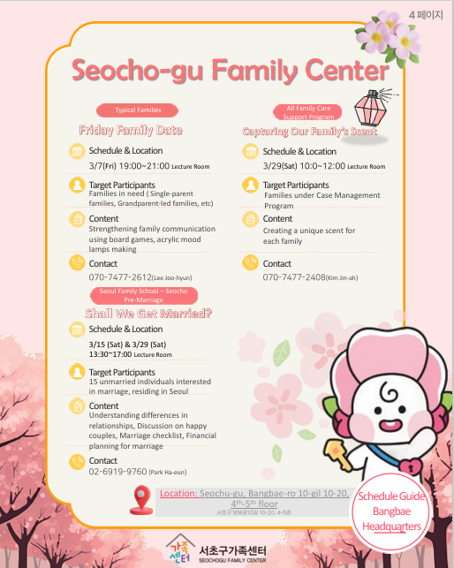

Slide 6
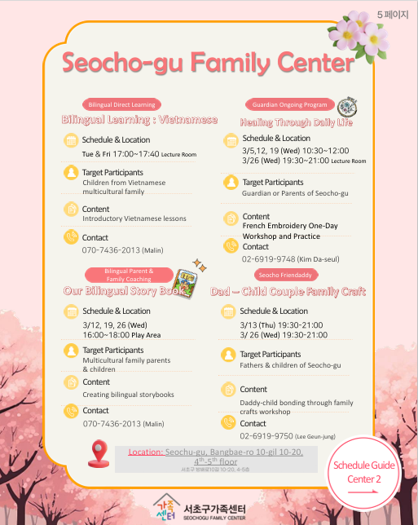

Slide 7
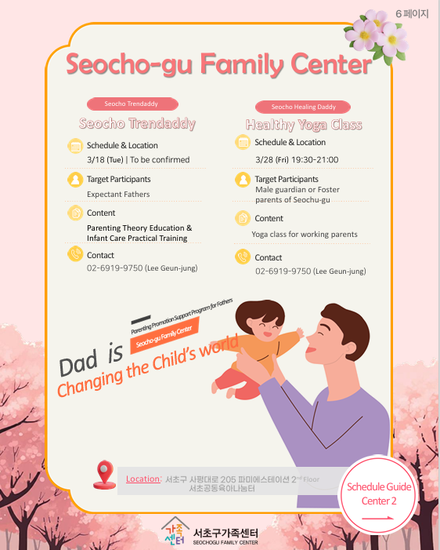

Slide 8



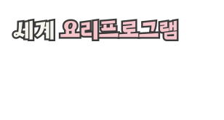
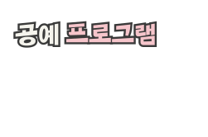





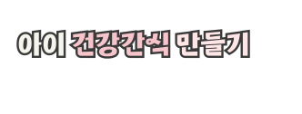
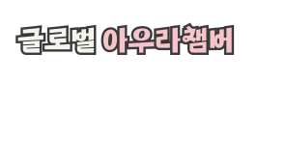
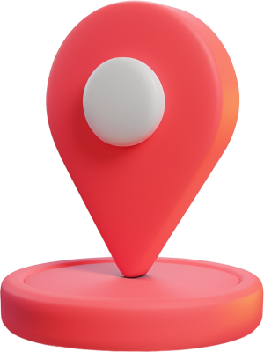




7 페이지
Seocho-gu Family Center
M(Mommy)-DAY
M(Mommy)-DAY
Schedule and location
Schedule and location
March 12일 (Wed) 10:30~12:30
March 10 (Mon)10:30~12:30
Target Participants
Target Participants
Mother living in Seocho-gu
Mother residing in Seocho-gu
Content
Content
Word cuisine program
Craft program for moms
Contact
Contact
070-7436-2011 (최호진)
070-7436-2011 (최호진)
M(Mommy)-DAY
Multicultural family growth support
글로벌 아우라 챔버
Schedule and location
Schedule and location
March 26 (Wed) 10:30~12:30
Wed 14:30~19:00
Target Participants
Target Participants
Mother living in seochu-gu
5 multicultural children and 1 adult
Content
Content
Makes healthy food for kids
Violin, Viola1:1 lesson
Contact
Contact
070-7436-2011 (최호진)
070-7477-2404 (박슬기)
Location: Seocho Mom Healing Center,301-1
Naegok SH Plaza,9-gil,Cheonggyesan-ro, Seocho-gu
Schedule guide
Center 3

Slide 9

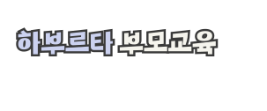
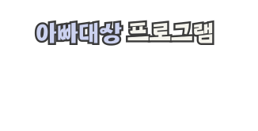


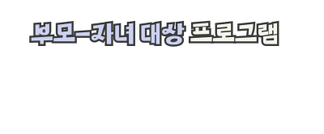
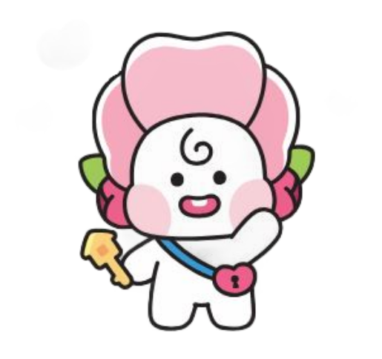




8 페이지
Seocho-gu Family Center
P(parents)-DAY
D(Daddy)-Day
Schedule and location
Schedule and location
Every thursday10:30~12:30
March 14 (Fri) 19:00~21:00
Target Participants
Target Participants
Parents living in Seocho-gu
Dad living in Seocho-gu
Content
Content
Haburta Parent Education
White day celebration program
Contact
Contact
070-7436-2011 (최호진)
070-7436-2011 (최호진)
F(Family)-DAY
Schedule and location
3/26(Wed) 10:30~12:30
Target Participants
Parents and child in Seocho-gu
Content
Making pet food for pets
Contact
02-573-2010 (문예슬)
Location: Seocho Mom Healing Center,301-1 Naegok SH
Plaza, 9-gil, Cheonggyesan-ro, Seocho-gu
Schedule guide
Center 3

Slide 10

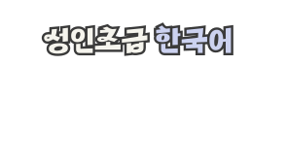
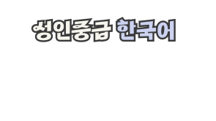




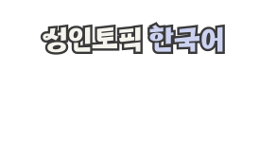
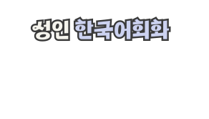
9 페이지
Seocho-gu Family Center
Korean class room
Korean class room
Schedule and location
Schedule and location
Tue, Thu10:00~12:00 ZOOM
Mon, Wed 10:00~12:00 ZOOM
Target Participants
Target Participants
Marriage immigrants,foreigners,
International student, etc.
Marriage immigrants,foreigners,
International student etc
Content
Content
Korean beginner class
Korean intermediate class
Contact
Contact
070-7456-2415 (정예승)
070-7456-2415 (정예승)
Korean class room
Korean class room
Schedule and location
Schedule and location
Tue, Thu 10:00~12:30 ZOOM
Tue, Thu 13:30~15:30 ZOOM
Target Participants
Target Participants
Marriage immigrants,foreigners,
International student etc
Marriage immi8grants,foreigners
,internation student etc
Content
Content
Korean topic class
Korean conversation class
Contact
Contact
070-7456-2415 (정예승)
070-7456-2415 (정예승)
Location: Seocho-gu Mom Healing Center.301-1 Naegok SH
Plaza.9-gil, Cheonggyesan-ro, Seocho-gu
Schedule guide
Center 3

Slide 11
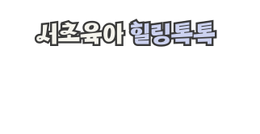
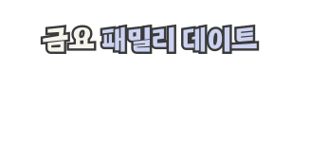



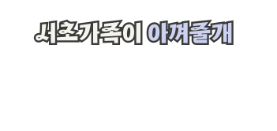



10 페이지
Seocho-gu Family Center
Seocho children healing list
A normal Family
Schedule and location
Schedule and location
March 15(Fri) 10:30-12:30
Seocho Eunhwa art hall
March 22(Fri) 10:00~12:00
Seoul Grand Park Zoo
Target Participants
Target Participants
Seocho-gu residents rasing preschool children
Vulnerable families such as single parents and grandparent
Content
Content
This is how I raised my child!
Lecture with Dr, Oh Eun-young
A trip to the Seoul Grand Park Zoo in Gwancheon
Contact
Cultural performance (Gambler Crew)
070-7477-2612(이주현)
Child experience program (care activities)
Miracle Family service Group
Contact
02-576-2852
(서초구가족센터 서초아이돌봄팀)
Schedule and location
March 22 (Sat) 13:50~17:00
Gyeonggi-do, Korean abandoned animal welfare association
Target Participants
Family volunteer group
Content
Volunteer work at an abandoned dog shelter
Contact
070-7477-9747(김수경)
Outside schedule information
아껴줄개

Slide 12


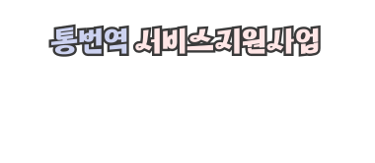
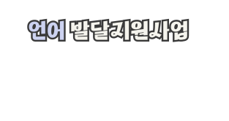



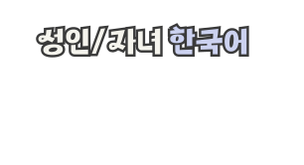
11 페이지
Seocho-gu Family Center
Interpretation and translation service support project
Multicultural familyy children language development support project
Progress target
Progress target
Multicultural families,foreigners,refugee families,related organization etc
Children from multicultural families under 12 years old
Content
Content
Interpreting,translation,and information provision
Language assessment,language promotion education parent counseling and education
Inquiries and application
Inquiries and application
070-7436-2012 (김윤아)
(Phone, visit,email)
070-7436-2423 (허미진)
(Phone,visit)
Constant consulation
Korean classroom
Progress target
Progress target
Anyone who wants to solve
Family/couple/individual difficulties
1.Marriage immi8grants,foreigners
international students etc
2. Multicultural children
Content
Content
Support for individual,couple(family). And Parent-child counseling for emotional recovery of individuals and families(Face-to-face only)
1. Beginner,intermediate,TOPIK, conversational
2. Classes 2. Korean for children ages 6-8
Inquiriesand application
Inquiries and application
070-7477-2410 (김정음)
(Phone reception)
070-7456-2415 (정예승)
(Submit Google after applying by phone)
Schedule guide regular business

Slide 13







11 페이지
Seocho-gu Family Center
Want more news?
seochohfsc
seochohfsc_1
Operation on Weekdays 9:00~18:00
※ Closed on weekends and public holidays
10-20 Bangbae-ro 10-gil, Seocho District, Seoul, 4-5 flr.
Operation on Weekdays 9:00~20:00
※ Closed on weekends and public holidays
Located on the 2nd floor of Seocho Cultural Arts Center
Seocho-gu Family Center(Headquarters)
Family education,family culture , children
Yangjae Counseling Center (Center1)
Seocho-gu Counseling/conversation room
for families
☎02-576-2852
☎070-7477-2410
Seoc hohfsc_2
seochohfsc_3
Operation on Weekdays 9:00~18:00 (Mon~Sat)
※ Closed on public holidays
Location on the 2nd floor of Pamies Station
Operation on Weekdays 9:30~17:30
※ Closed on weekends and public holidays
Located on the 3rd floor of Naegok SH Plaza
Co-parenting Sharing Center
(Center2)
Seocho-gu space for children and the elderly
Seocho-gu Mom healing
(Center 3)
A realaxing/cultural space for mother
and families
☎02-6919-9748
☎02-573-2010
Promotional Channel
Following

Slide 14


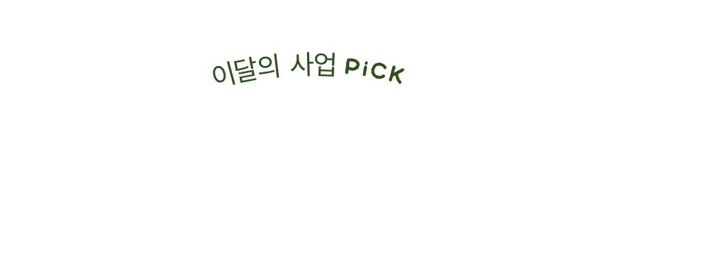
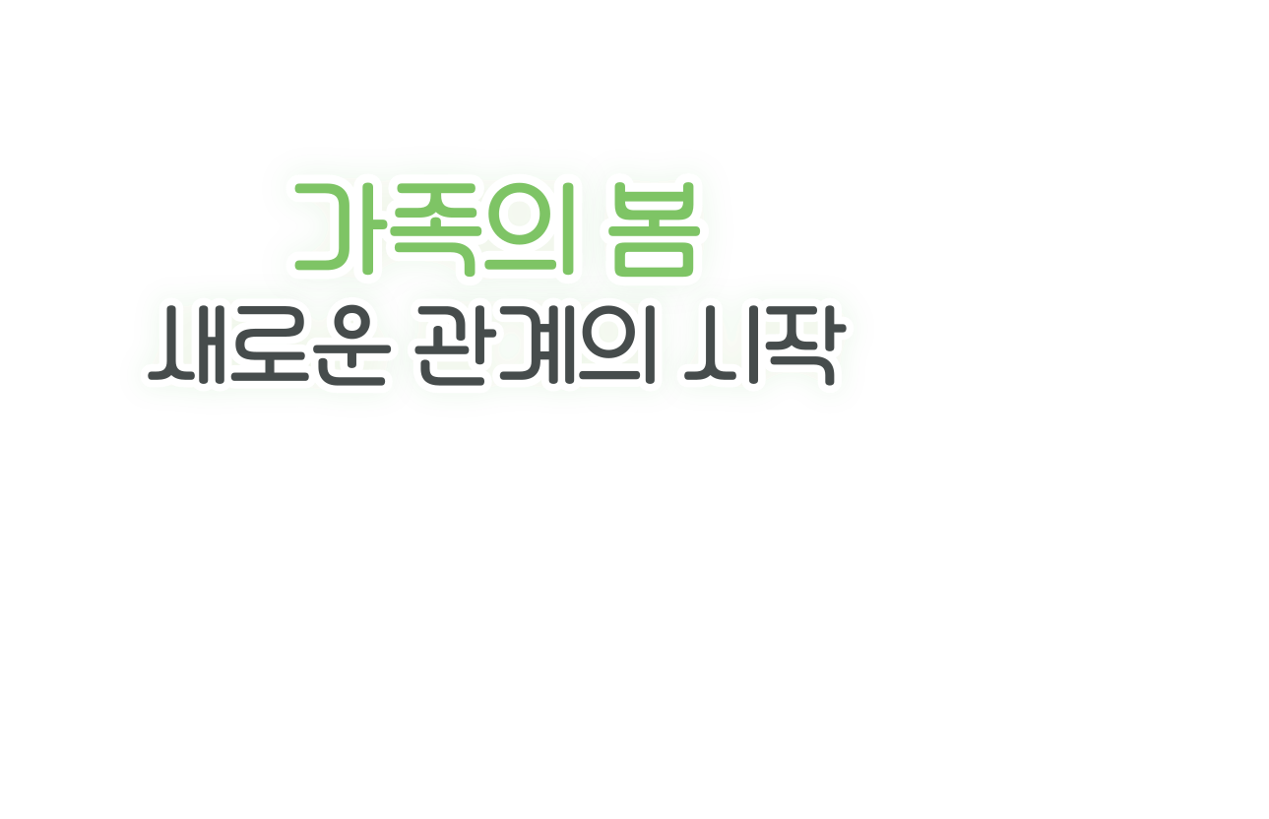















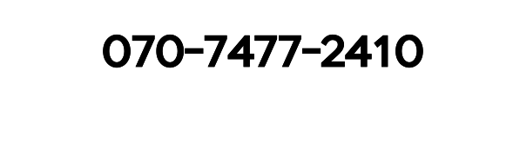








서로의 진심을 나누며 한 걸음 가까워지는 시간을 가져보세요
Inquiry
Family counseling Couple counseling Parent-child conseling
문의
교육분야

